Slide 1


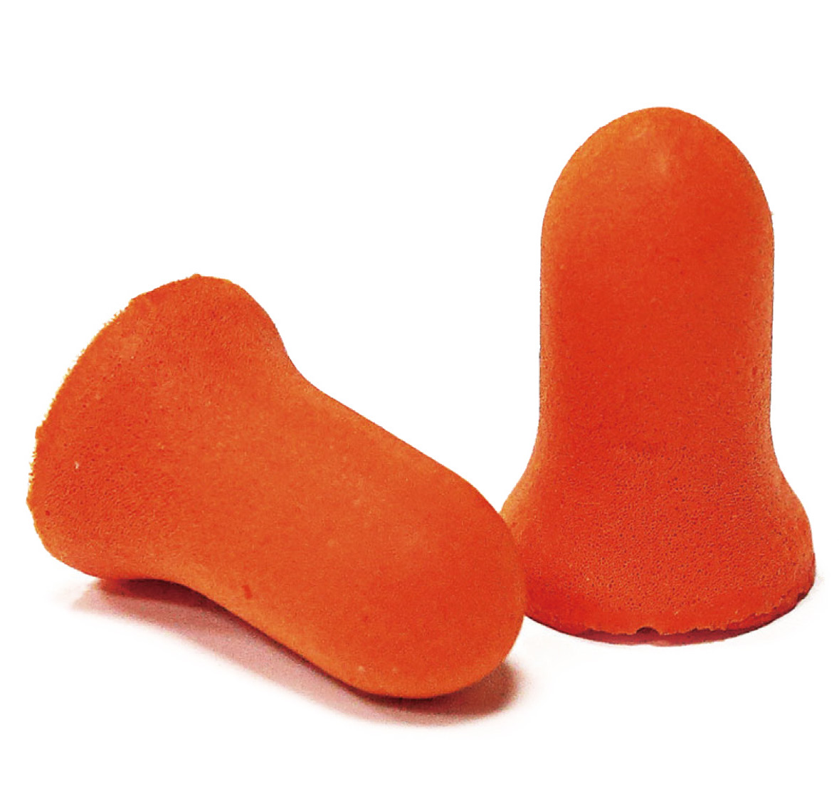
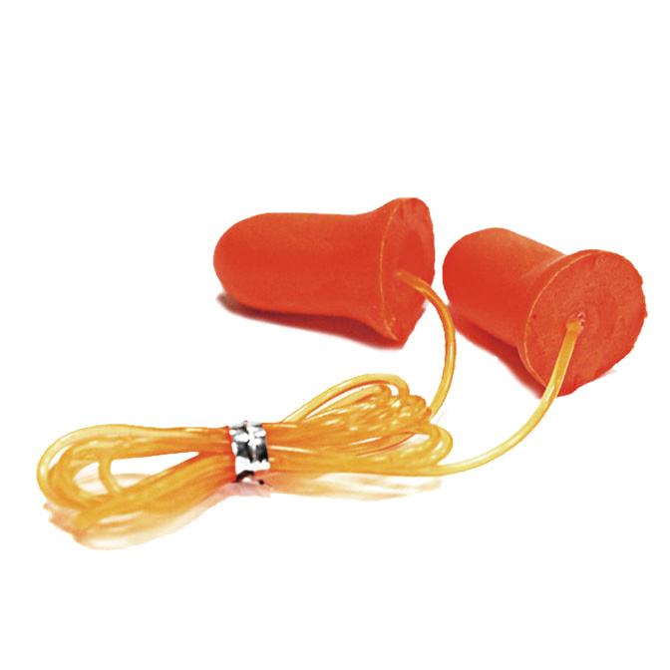
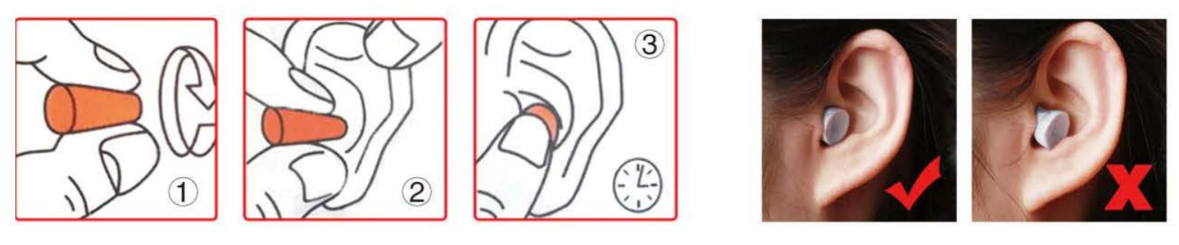
Hearing Protection
SA-7-4 Noise Proof Safety Earplug
Material : Polyurethane Foam
Shape : Bell Shape
String : Available for Plastic string
Color Available: Orange, Yellow, Red, Blue etc
Sound Proof: SNR 37dB
CE EN352-2:2002.
ANSI S3.19-1974
Application : Construction, Road & Building Workers, Forest & Wood Workers, Mining, Mechanics, Factory Workshop, Shooting, Sleep etc
Users Instruction:
1.) FITTING INSTRUCTIONS：
⚫ Move your hair out of the way to get a good seal between the earplug and your head. Remove earrings if they interfere with the seal of the earplugs against your head.
⚫ Press the earplug smaller before push it inside your ear. Hold it about 3-5 seconds.
⚫ The earplug will rebound slowly, and fullfil your ear. It will take about 5-10 seconds, maybe more time accoding to temperature around you.
⚫ Check the fit by talking out loud. Your voice should sound hollow, like you are talking in a barrel. The noises around you should not sound as loud as they did before you put the earplug on.
2.) THE USER SHOULD ENSURE:
⚫ The Earplugs are fitted, adjusted and maintained in accordance with the manufacturer’s instructions
⚫ The Earplugs are worn at all times in noisy surroundings
⚫ The Earplugs are regularly inspected for serviceability
3.) LIFESPAN
The Safety Earplug can be expected to remain in service for 3 years or more, when it is not damaged during use.
4.) CLEANING AND DISINFECTION
The safety earplugs are disposable use. Do not use paints, solvents, chemicals, adhesives, gasoline or like substances on this earplug. The hearing protection resistance and other protective properties of the earplug may be destroyed by such substances. The loss of these protective properties may not be apparent or readily detectable by the user.
5.) STORAGE
Store the earplug in a cool, dry and clean place out of direct sunlight. Avoid area where heat, moisture, light, oil, or their vapours or other degrading elements may be present.

